Slide 1

10. Application For Grocery Delivery

Slide 2

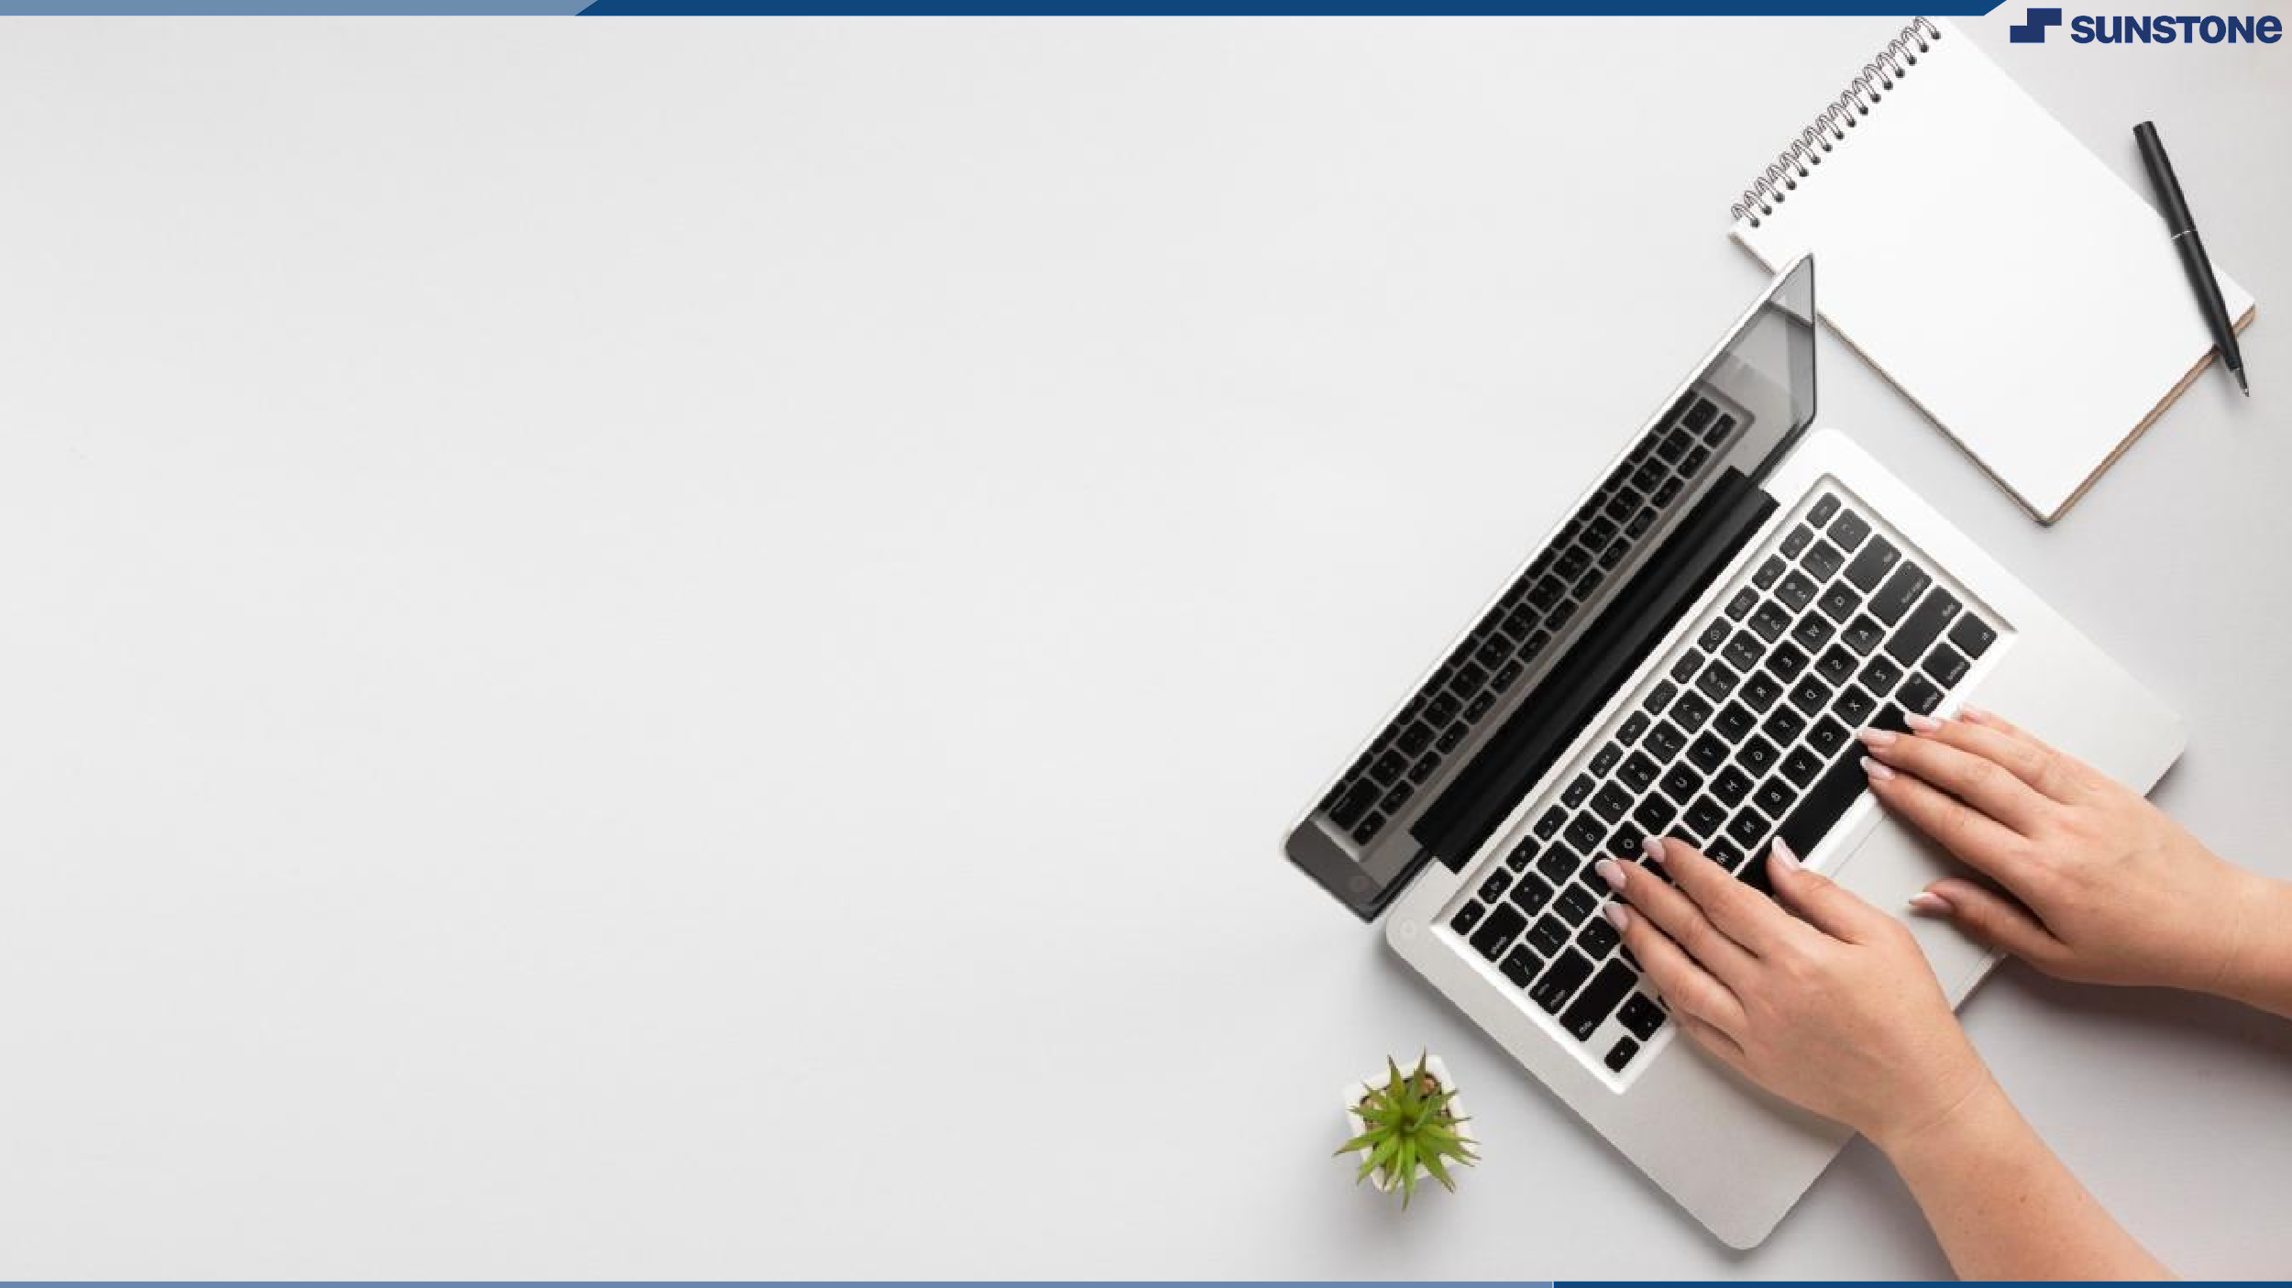
Application For Grocery Delivery
A grocery delivery website or application is among the best projects for full-stack developers to showcase their talent and skills. You can learn multiple factors related to large-scale full-stack apps or websites by making the grocery delivery application project. It involves back-end knowledge and helps you excel in making major projects in the future.

Slide 3
YOUR PROJECT NAME
Application For Grocery Delivery
USERNAME | NAME | BATCH
2108a31208 | Madhumitha Alamu. S | A31
2108a31209 | Kaviya. J | A31
2108a31210 | Sowmiya. V | A31

Slide 4
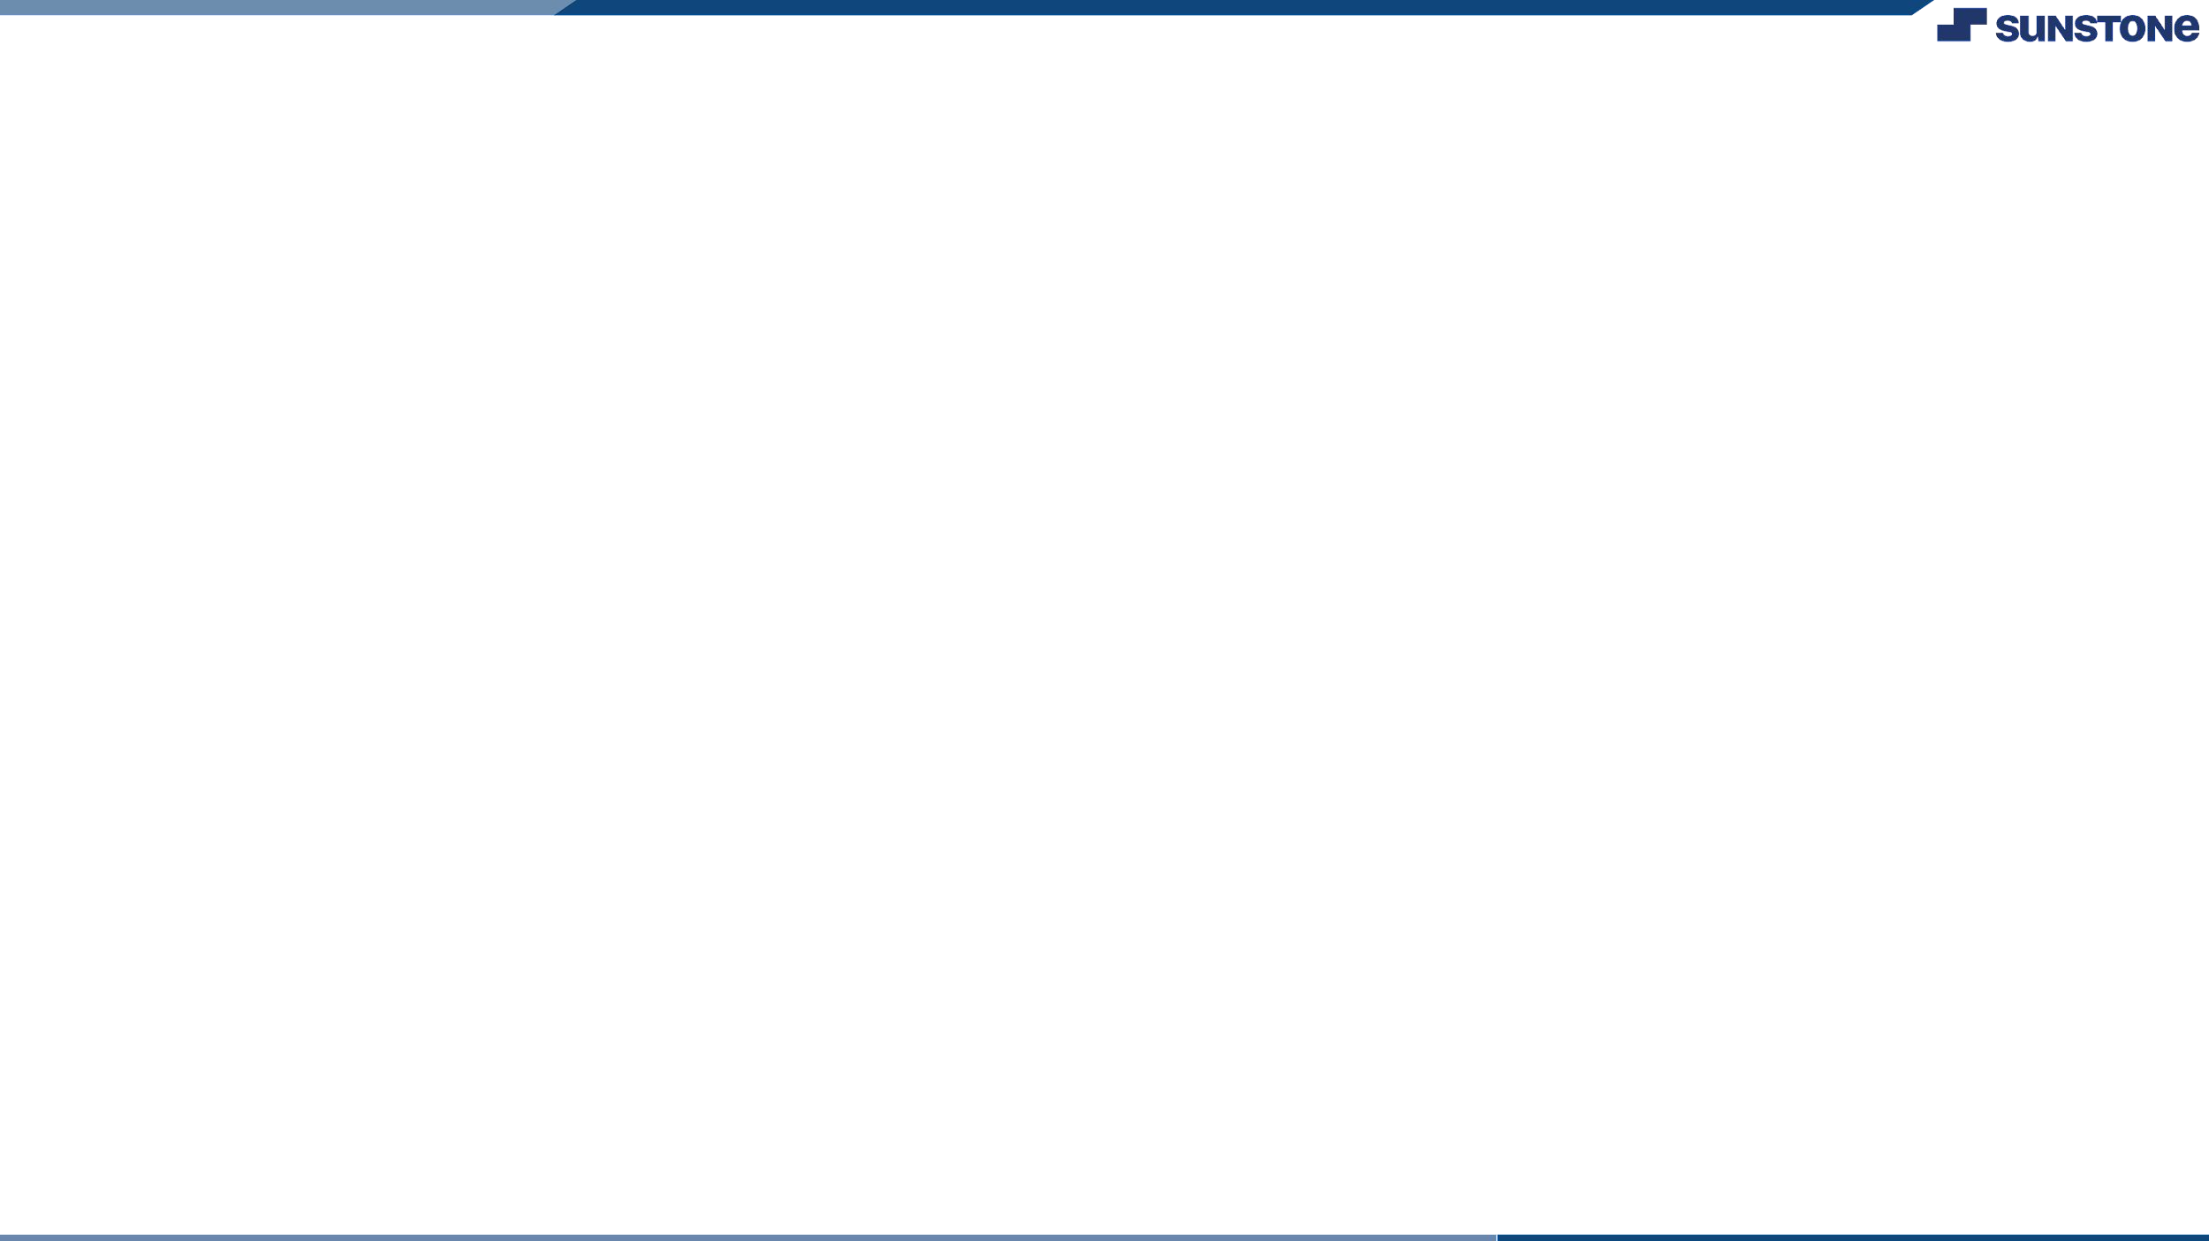
Task 1 :: SDP (Module 1)
ABSTRACT
The purpose of the Grocery Store Management System is to automate the existing manual system with the help of computerized equipment and full-fledged computer software, fulfilling their requirements, so that their valuable data/information are often stored for an extended period with easy accessing
SCOPE
The aim of this project it to give information about the content of any shopping center to anyone who so wants to check current prices of available products, order products, spend less time in the market and shopping centers to reduce the stress and hustle of shopping and finding of customers.

Slide 5
Task 1 :: SDP (Module 1)
REQUIREMENTS
➢ Functional Requirement ▪ This section provides requirement overview of the system
➢ Registration
▪ If customer wants to buy the product then he/she must be registered, If , unregistered the user can only view the products but they cannot buy it
➢ Login
▪ Customer logins to the system by entering valid user id and password for the shopping.
➢ Cart Options
▪ It insist that the customer after making login or registration , They can order or cancel order of the product from the shopping cart.
➢ Payment
▪ In this system we are dealing with the mode of payment by Cash initially.
▪ We will extend this to credit card , debit card etc in the future.

Slide 6
Task 1 :: SDP (Module 1)
REQUIREMENTS
➢ Logout
▪ After ordering or surfing for the product , The customer has to logout if needed
➢ Report Generation
▪ After ordering for the product , The system will sent one copy of the bill to the customer’s Email-address and another one for the system data base.
➢ NON FUNCTIONAL REQUIREMENTS
▪ Secure
▪ Reliable
▪ Easy Maintenance
▪ Portable
▪ Reusability
▪ Resource utilization.

Slide 7
Task 1 :: SDP (Module 1)
➢ SOFTWARE REQUIREMENTS
▪ operating system : Linux or window XP/7/8/8.1
▪user interface : HTML,CSS
▪ client-side scripting : javaScript
▪programming language : javaScript
➢HARDWARE REQUIREMENTS
▪ Memory : 6 GB
▪ Processor Type : Intel pentium,i3,i5,i7 or faster
▪ Processor speed : 1.83 GHz or faster processor, Intel pentium compatible
▪ Swap space : 2.1 GB
▪ Hard Disk Space : 500GB or less

Slide 8
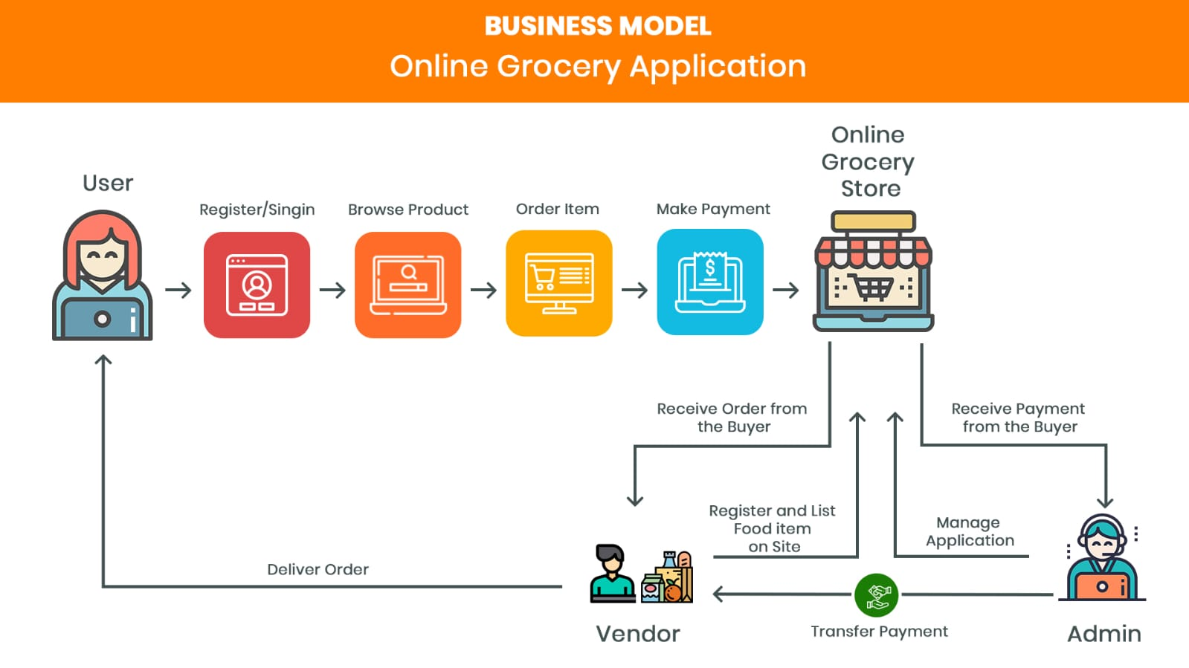
Task 1 :: SDP (Module 1)

Slide 9
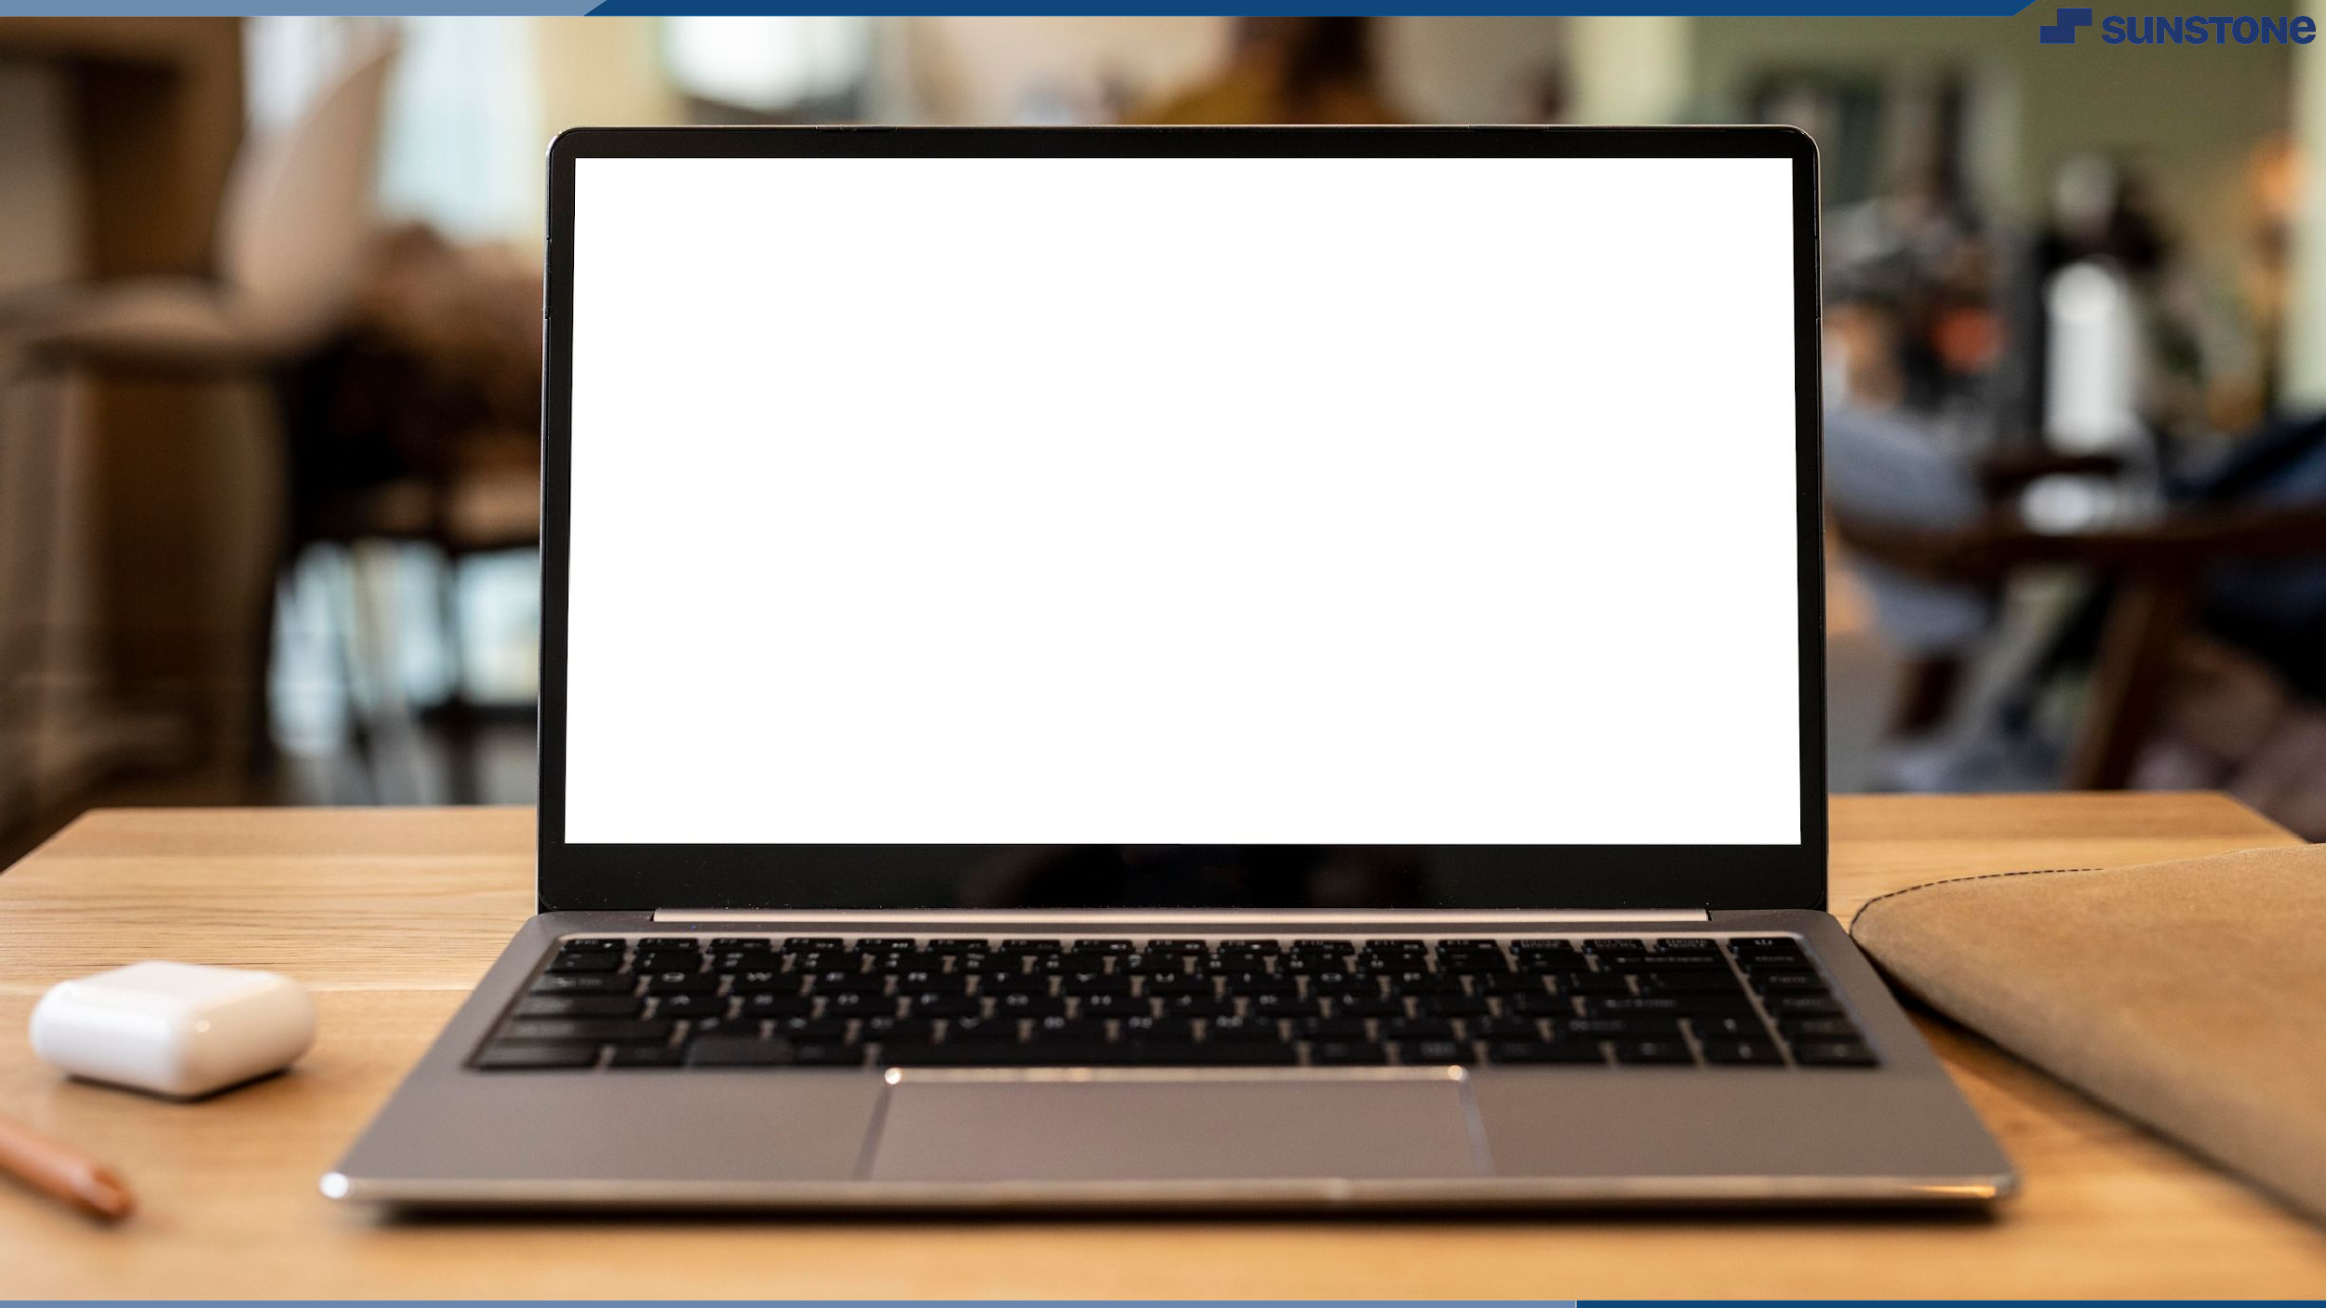

delivery
Application For Grocery
Click here

Slide 10
